Slide 1
SysML 1.4: Quantities, Units, Dimensions & Values (QUDV) & ISO 80000 Library
Nicolas Rouquette
Jet Propulsion Laboratory
California Institute of Technology
March 2014
Copyright 2013, 2014, California Institute of Technology (“Caltech”) U.S. Government sponsorship acknowledged. All rights reserved.

Slide 2
What is ISO/IEC 80000?
Standards-Development Organizations (the OMG is a much smaller SDO compared to ISO/IEC):
ISO: International Standards Organization
IEC: International Electrotechnical Commission
ISO/IEC 80000 is a collection of 14 standards (called parts):
Part 1: General information & definitions about quantities & units (covers a subset of VIM chapter 1 “quantities & units” – see below)
Part 2: Mathematical symbols & notation
Parts 3-14: Tables of domain-specific definitions of quantities & units
Brief history:
1875: International Bureau of Weights and Measures (BIPM) formed to “establish fundamental standards & scales for the measurement of the principal physical quantities & maintain the international prototypes”
1970: First publication of the “International System of Units” (SI brochure)
http://www.bipm.org/en/si/si_brochure/
1997: First publication of “Guide of expression of Uncertainty in Measurement” (GUM) and “Vocabulary of International Metrology” (VIM)
http://www.bipm.org/en/publications/guides/gum.html
http://www.bipm.org/en/publications/guides/vim.html
2009: All 14 parts in ISO/IEC 80000 published

Slide 3
Topics
What is ISO/IEC 80000?
Coverage of ISO/IEC 80000 in SysML 1.4
Brief Introduction to QUDV
Organization of the library
Using the library
Modeling Values of Scalar & Structured ValueTypes
Extending the library
Dimensional Analysis
Backup Material / Technical Details
History; • Technical Issues;
Differences between SysML & QUDV Vocabularies;
Modeling ValueTypes & ValueSpecifications;
Example of Structured vs. Scalar DataType Modeling
Notes:
----- Meeting Notes (3/14/14 15:00) -----
representation of instances….
in UML vs. in some other tool…

Slide 4
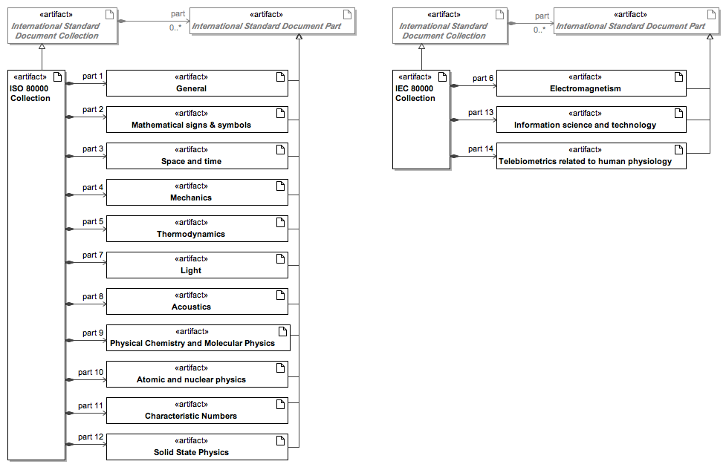
What is ISO/IEC 80000 ?
Each document part is identified by:
The publication date (e.g., ISO 80000-1:2009)
An edition number (e.g., 1st edition)
Technical Corrigendum (as applicable)

Slide 5
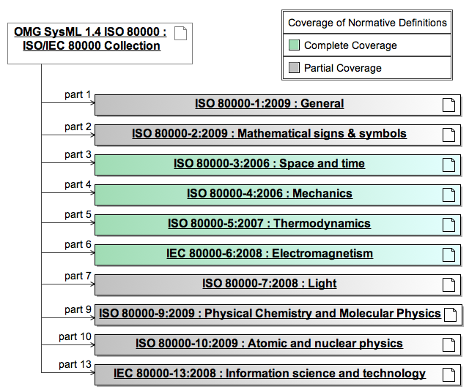
Coverage of ISO/IEC 80000 in SysML 1.4 (non-normative Annex E.6)
SysML’s
QUDV

Slide 6
Scope of Coverage in SysML 1.4 (non-normative Annex E.6)
No coverage in SysML 1.4 for:
Part 8 Acoustics
Part 11 Characteristic Numbers
Part 12 Solid-state physics
Part 14 Telebiometrics related to human physiology
(contributions welcome!)
Notes about coverage of ISO/IEC 80000 in SysML 1.4:
Schedule (SysML 1.4 RTF ended December 2013)
Base quantities & units (parts 3,4,5,6,7,9)
Improving QUDV to encode ISO/IEC 80000 definitions
Domain-specific knowledge required
=> Needs peer review and contributions!

Slide 7
Brief Introduction to QUDV (Quantities, Units, Dimensions & Values) (non-normative Annex E.5)
Why QUDV?
SysML has the concept of ‘quantity’ [VIM 3-1.1]
“property of a phenomenon, body or substance, where the property has a magnitude that can be expressed as a number and a reference”
SysML 1.1 had limited vocabulary: Unit & Dimension
SysML lacked the concept of ‘kind of quantity’ [VIM 3-1.2]
aspect common to mutually comparable quantities
QUDV first introduced in SysML 1.2 & subsequently revised
SysML 1.4 & QUDV:
Improved alignment with VIM 3rd edition, JCGM 200:2012
Adequate for modeling a significant scope of ISO/IEC 80000
Semantics allow for computer-based Dimensional Analysis!
See #48 for an overview of the scope of the SysML & QUDV vocabularies

Slide 8
Using VIM 3rd edition in SysML 1.4 & QUDV
http://www.bipm.org/en/publications/guides/vim.html
 |  | Normative SysML |  | Non-normative QUDV & ISO-80000
1 | Quantities and units (30 definitions) | language concept | modeling pattern | language concept | modeling pattern | ISO-80000-1 Library
1.1 | quantity | ✔
1.2 | kind of quantity |  |  | ✔
1.3 | system of quantities |  |  | ✔
1.4 | base quantity |  |  | ✔
1.5 | derived quantity |  |  | ✔
1.6 | International System of Quantities (ISQ) |  |  |  |  | ✔
1.7 | quantity dimension |  |  | ✔
1.8 | quantity of dimension one |  |  | ✔
1.9 | measurement unit | ✔
1.10 | base unit |  |  | ✔
1.11 | derived unit |  |  | ✔
1.12 | coherent derived unit |  |  |  | ✔
1.13 | system of units |  |  | ✔
1.14 | coherent system of units |  |  |  | ✔
1.15 | off-system measurement unit |  |  |  | ✔
1.16 | International System of Units (SI) |  |  |  |  | ✔
1.17 | multiple of a unit |  |  | ✔
1.18 | submultiple of a unit |  |  | ✔
1.19 | quantity value |  | ✔
1.20 | numerical quantity value |  | ✔
1.21 | quantity calculus |  |  |  | ✔
1.22 | quantity equation |  |  | ✔
1.23 | unit equation |  |  | ✔
1.24 | conversion factor between units |  |  | ✔
1.25 | numerical value equation |  | ✔
1.26 | ordinal quantity |  | ✔
1.27 | quantity-value scale
1.28 | ordinal quantity-value scale |  | ✔ |  | ✔
1.29 | conventional reference scale |  | ✔ |  | ✔
1.30 | nominal property |  |  |  | ✔
 |  | No Coverage in QUDV or SysML
2 | Measurement | (53 definitions)
3 | Devices for measurement | (12 definitions)
4 | Properties of measuring devices | (31 definitions)
5 | Measurement standards (etalons) | (18 definitions)
See #46 for references

Slide 9
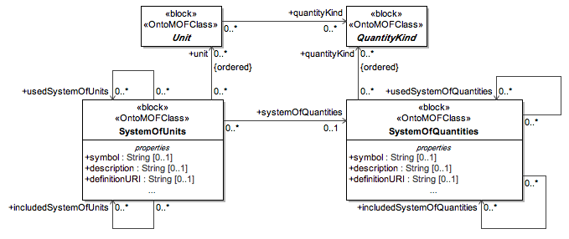
Systems of Units & Quantity Kinds
 |  | Normative SysML |  | Non-normative QUDV & ISO-80000
Def. | Quantities and units (30 definitions) | language concept | modeling pattern | language concept | modeling pattern | ISO-80000-1 Library
1.3 | system of quantities |  |  | ✔
1.6 | International System of Quantities (ISQ) |  |  |  |  | ✔
1.13 | system of units |  |  | ✔
1.16 | International System of Units (SI) |  |  |  |  | ✔

Slide 10
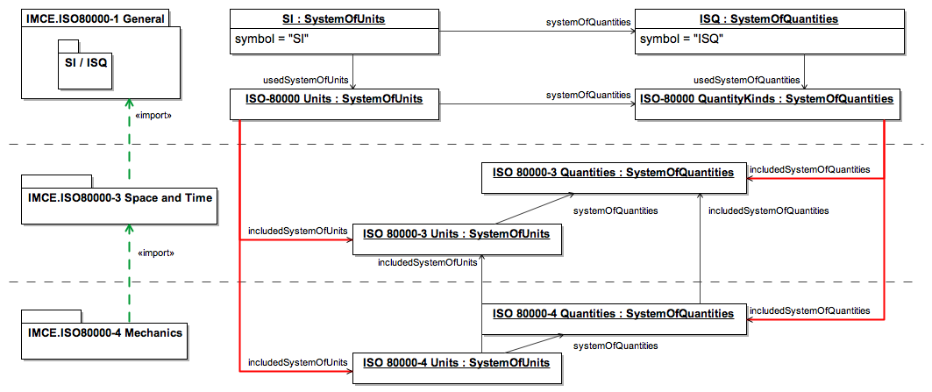
Systems of Units & Quantity Kinds
 |  | Normative SysML |  | Non-normative QUDV & ISO-80000
Def. | Quantities and units (30 definitions) | language concept | modeling pattern | language concept | modeling pattern | ISO-80000-1 Library
1.3 | system of quantities |  |  | ✔
1.6 | International System of Quantities (ISQ) |  |  |  |  | ✔
1.13 | system of units |  |  | ✔
1.16 | International System of Units (SI) |  |  |  |  | ✔
See #44 for SysML issue #16263 preventing modularizing OMG SysML 1.4 ISO-80000 library
See #45 for JPL’s modularization where <<import>> has a strong separation semantics

Slide 11
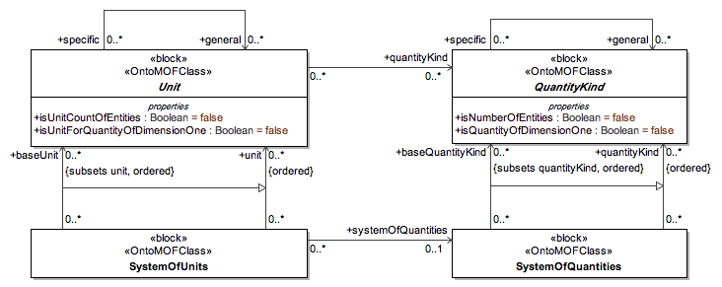
base quantity kinds (ISQ) & base units (SI)
 |  | Normative SysML |  | Non-normative QUDV & ISO-80000
1 | Quantities and units (30 definitions) | language concept | modeling pattern | language concept | modeling pattern | ISO-80000-1 Library
1.2 | kind of quantity |  |  | ✔
1.4 | base quantity |  |  | ✔
1.9 | measurement unit | ✔
1.10 | base unit |  |  | ✔
1.17 | multiple of a unit |  |  | ✔
See #47 for more information about taxonomic relationships in metrology
(i.e., general/specific units/quantity kinds)

Slide 12
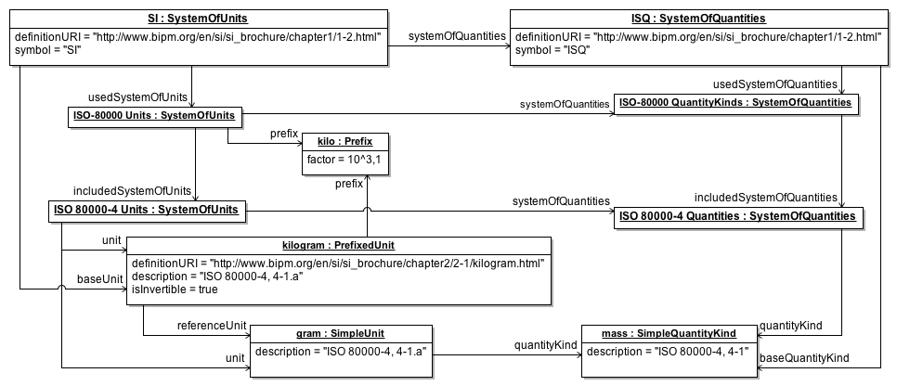
base quantity kinds (ISQ) & base units (SI)
 |  | Normative SysML |  | Non-normative QUDV & ISO-80000
1 | Quantities and units (30 definitions) | language concept | modeling pattern | language concept | modeling pattern | ISO-80000-1 Library
1.2 | kind of quantity |  |  | ✔
1.4 | base quantity |  |  | ✔
1.9 | measurement unit | ✔
1.10 | base unit |  |  | ✔
1.17 | multiple of a unit |  |  | ✔

Slide 13
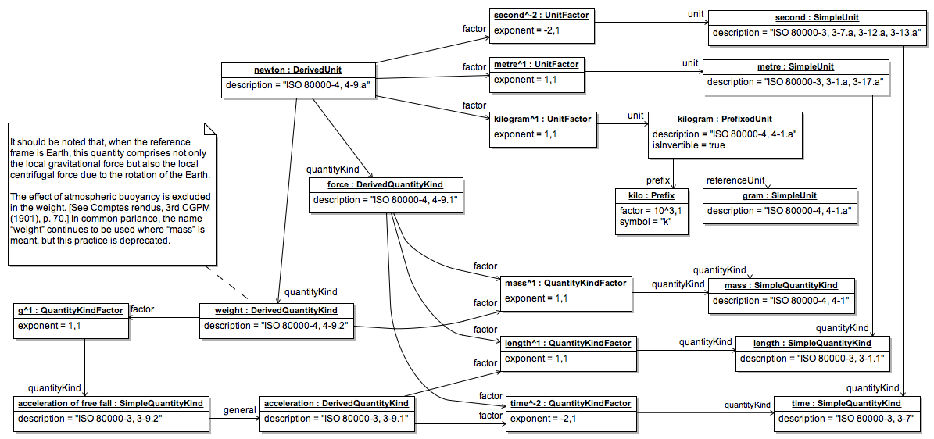
Example of Derived Definitions
Definitions illustrated in this figure |  | Count
1.5 | derived quantity |  | 3
1.11 | derived unit |  | 1
1.22 | quantity equation |  | 3
1.23 | unit equation |  | 2
In SysML 1.4, ISO 80000 has definitions for:
- 325 quantity kinds
- 191 non-prefixed units; 2564 prefixed units

Slide 14
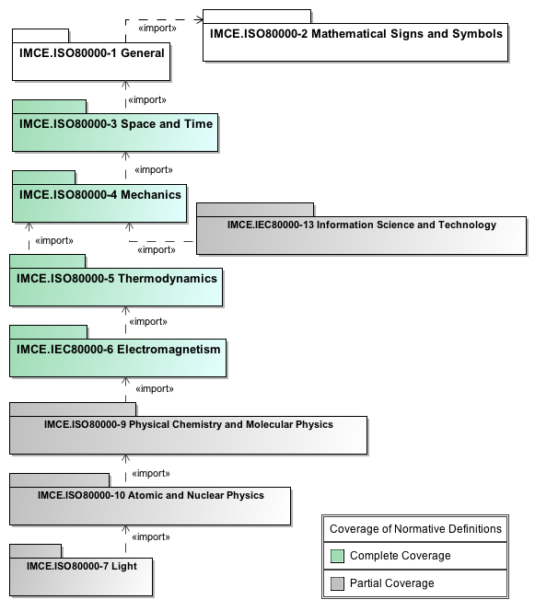
Organization of the ISO 80000 Library
Practical Perspective:
Using the library
Extending the library
Dimensional Analysis
Notes:
OMG SysML 1.4 ISO 80000 uses <<import>> with
a stronger modularity semantics than defined in UML
In OMG SysML 1.4 ISO 80000, [X] <<import>> [Y] means:
Some definition in [X] depends on some definition in [Y]
No definition in the <<import>> closure of [Y] depends on any definition in [X]
In most cases: ISO/IEC document part [X] has a normative reference to ISO/IEC document part [Y]
(A stereotype extending PackageImport would have been appropriate to indicate the above semantics)
See #46 for Normative References vs.
Semantic Dependencies

Slide 15
1) Using the ISO-80000 Library
Example: Modeling the position of a point on a 2D Cartesian plane
Modularity: Import ISO 80000-3 (space & time)
(this part suffices for this application)
Goal: Represent in SysML the following points in the 2D plane:
Origin (x=0mm, y=0mm)
p1 (x=1 mm, y=1 mm)
p2 (x=2 mm, y=0.5 mm)
p3 (x=2.5 mm, y=2 mm)

Slide 16
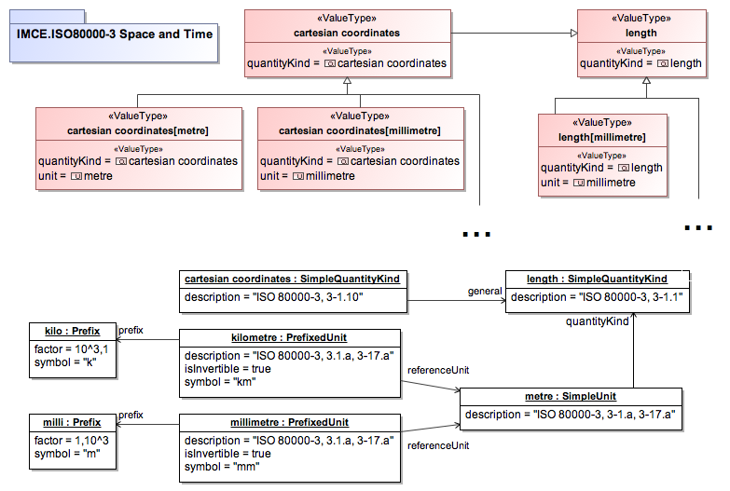
Relevant Subset of ISO 80000-3 for 2D Cartesian geometry example
See #54 for practical considerations about naming ValueTypes

Slide 17
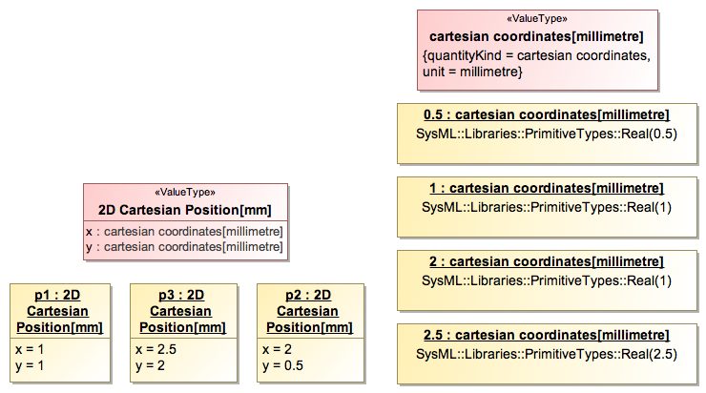
2D Cartesian Geometry Example (Scalar & Structured Values)
See #55 for an alternative paradigm for modeling Values & ValueTypes

Slide 18
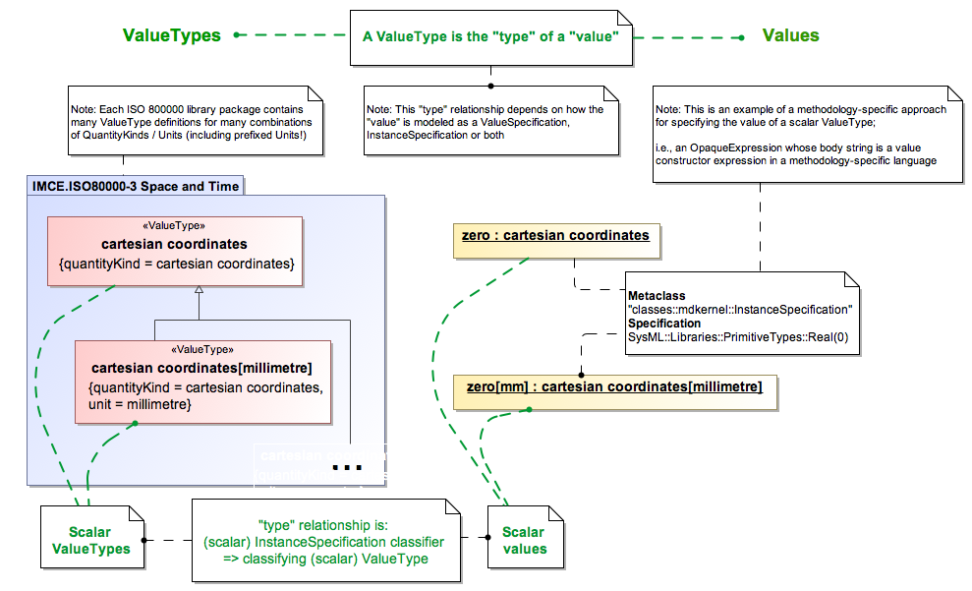
2) Modeling Values of Scalar ValueTypes
Notes:
----- Meeting Notes (3/14/14 15:00) -----
value property first...

Slide 19
Modeling Values of Scalar ValueTypes
IMPORTANT CLARIFICATION !
In SysML, values do not have a ‘unit’ per se (e.g., “42mm” is not a value in SysML!)
In SysML, values have an optional ‘unit’ through their type (i.e., a SysML ValueType)
Notes:
----- Meeting Notes (3/14/14 15:00) -----
value property first...

Slide 20
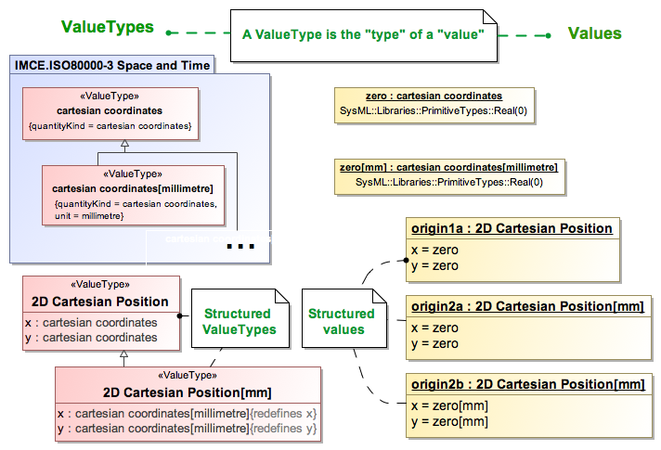
Modeling Values of Structured ValueTypes
Notes:
----- Meeting Notes (3/14/14 15:00) -----
add a tag: which of these is an appropriate way to define the origin?

Slide 21
Modeling Values of Structured ValueTypes
IMPORTANT CLARIFICATION !
Although SysML values do not have a ‘unit’ per se, Value / ValueType Conformance is essential (otherwise a value has no meaning in SysML)
Notes:
----- Meeting Notes (3/14/14 15:00) -----
add a tag: which of these is an appropriate way to define the origin?

Slide 22
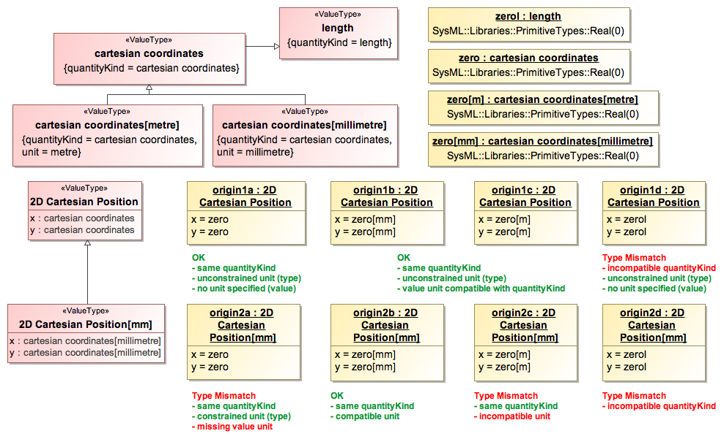
Type Checking: Value / ValueType Conformance
See #51 for practical considerations about modeling values
See #55 for a comparison between structured & monadic ValueType modeling

Slide 23
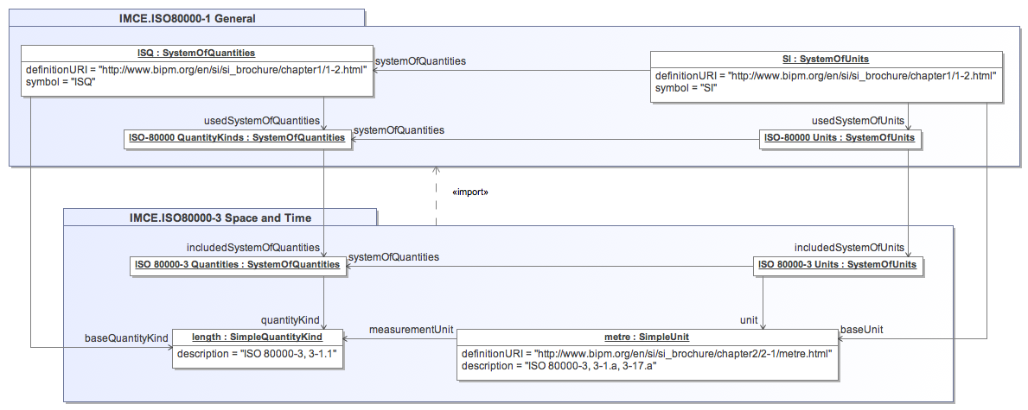
3) Extending the ISO-80000 Library
Goal: Define ‘yard (US survey)‘
Extend ISO 80000-3 (Space & Time)
(Identify the relevant ISO 80000 library)

Slide 24
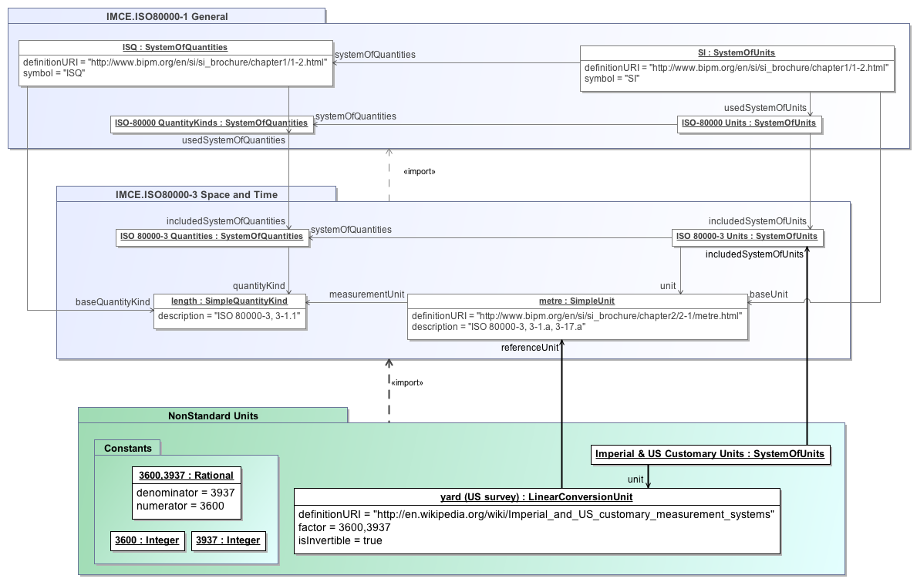
Extending the ISO-80000 Library (cont)
(extension)

Slide 25
4) Dimensional Analysis with QUDV
What is Dimensional Analysis useful for?
Checking consistency of derivations between quantities and corresponding units
Calculating the dimension of derived quantities as a product of the dimensions of other quantities
Checking the derivation of quantities of dimension one
Converting scale-dependent models (with dimensioned quantities) to equivalent scale-independent models (with quantities of dimension 1)
For more information, see:
http://www.bipm.org/en/si/si_brochure/chapter1/1-3.html
http://en.wikipedia.org/wiki/Dimensional_analysis

Slide 26
Dimensional Analysis Example: Checking the derivation of quantities of dimension one
Reynolds number is well-known ‘dimensionless’ quantity used for developing scale models of fluid dynamic systems
If a model is expressed in terms of ‘dimensionless’ quantities only, then the model can be scaled
Scaled models are useful for simulating non-linear phenomena in the lab (e.g. supersonic flight, …)
Use SysML 1.4 QUDV for dimensional analysis!

Slide 27
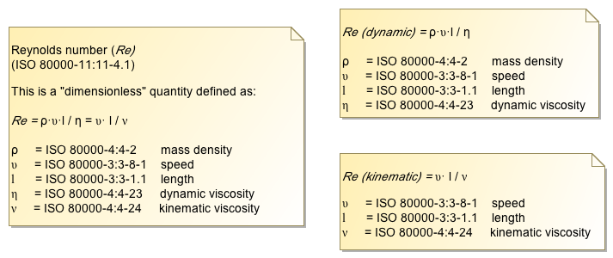
QUDV-based Dimensional Analysis: Reynolds number
Typically, a dimensionless quantity has multiple formulations
Redundancy is a good thing for dimensional analysis!
Check that all equivalent formulations have equivalent dimensions
Reynolds number can be formulated in 2 ways:

Slide 28
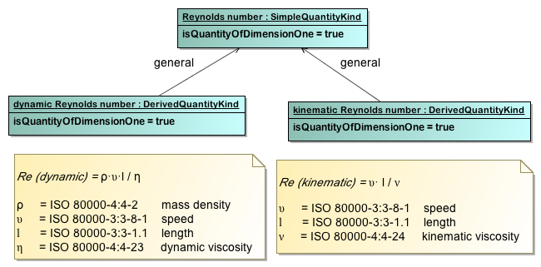
Redundant Modeling of Dimensionless Quantities
QUDV support for VIM-based taxonomic relationships among quantities is essential!
dynamic & kinematic formulations must be equivalent
Therefore, they must have equivalent dimensions!

Slide 29
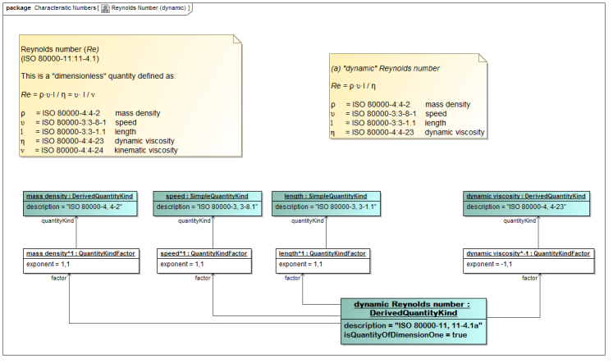
Elaborate the Redundant Formulations (1/2)

Slide 30
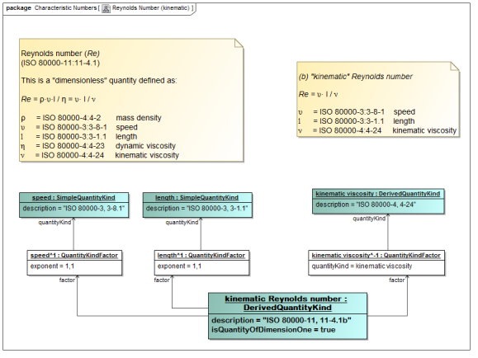
Elaborate the Redundant Formulations (2/2)

Slide 31
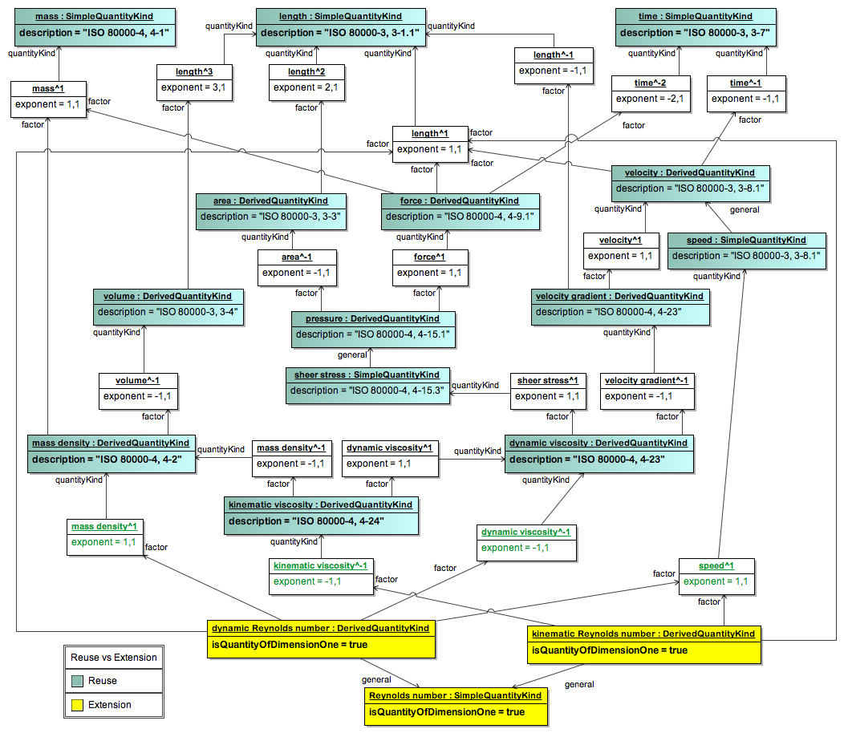
Reuse and/or Extend the ISO 80000 library to include derivations for all quantities relevant to the analysis
Thanks to comprehensive coverage of ISO 80000 parts 3,4,5,6, this example requires defining only 3 derived quantity kinds!

Slide 32
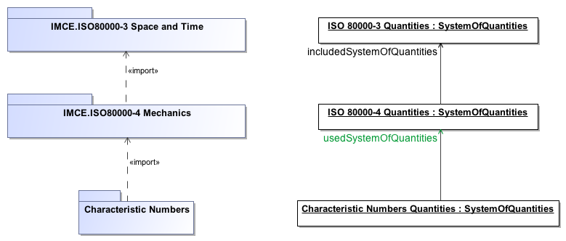
Dimensional Analysis in context of a System of Quantities
Expressing a derived quantity as a product of the powers of base quantities requires specifying the context for this analysis, i.e., a SystemOfQuantities
In this example, context = ‘Characteristic Numbers Quantities’

Slide 33
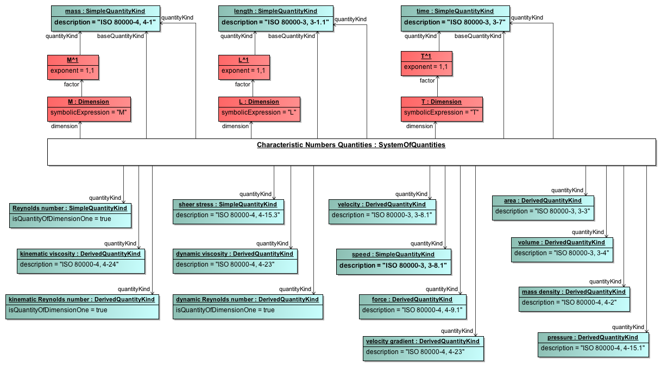
Context for the Dimension Analysis of Reynolds number redundant formulations
Dimension Analysis requires choosing a set of base quantities
For this example: Mass (M), Length (L), Time (T)

Slide 34
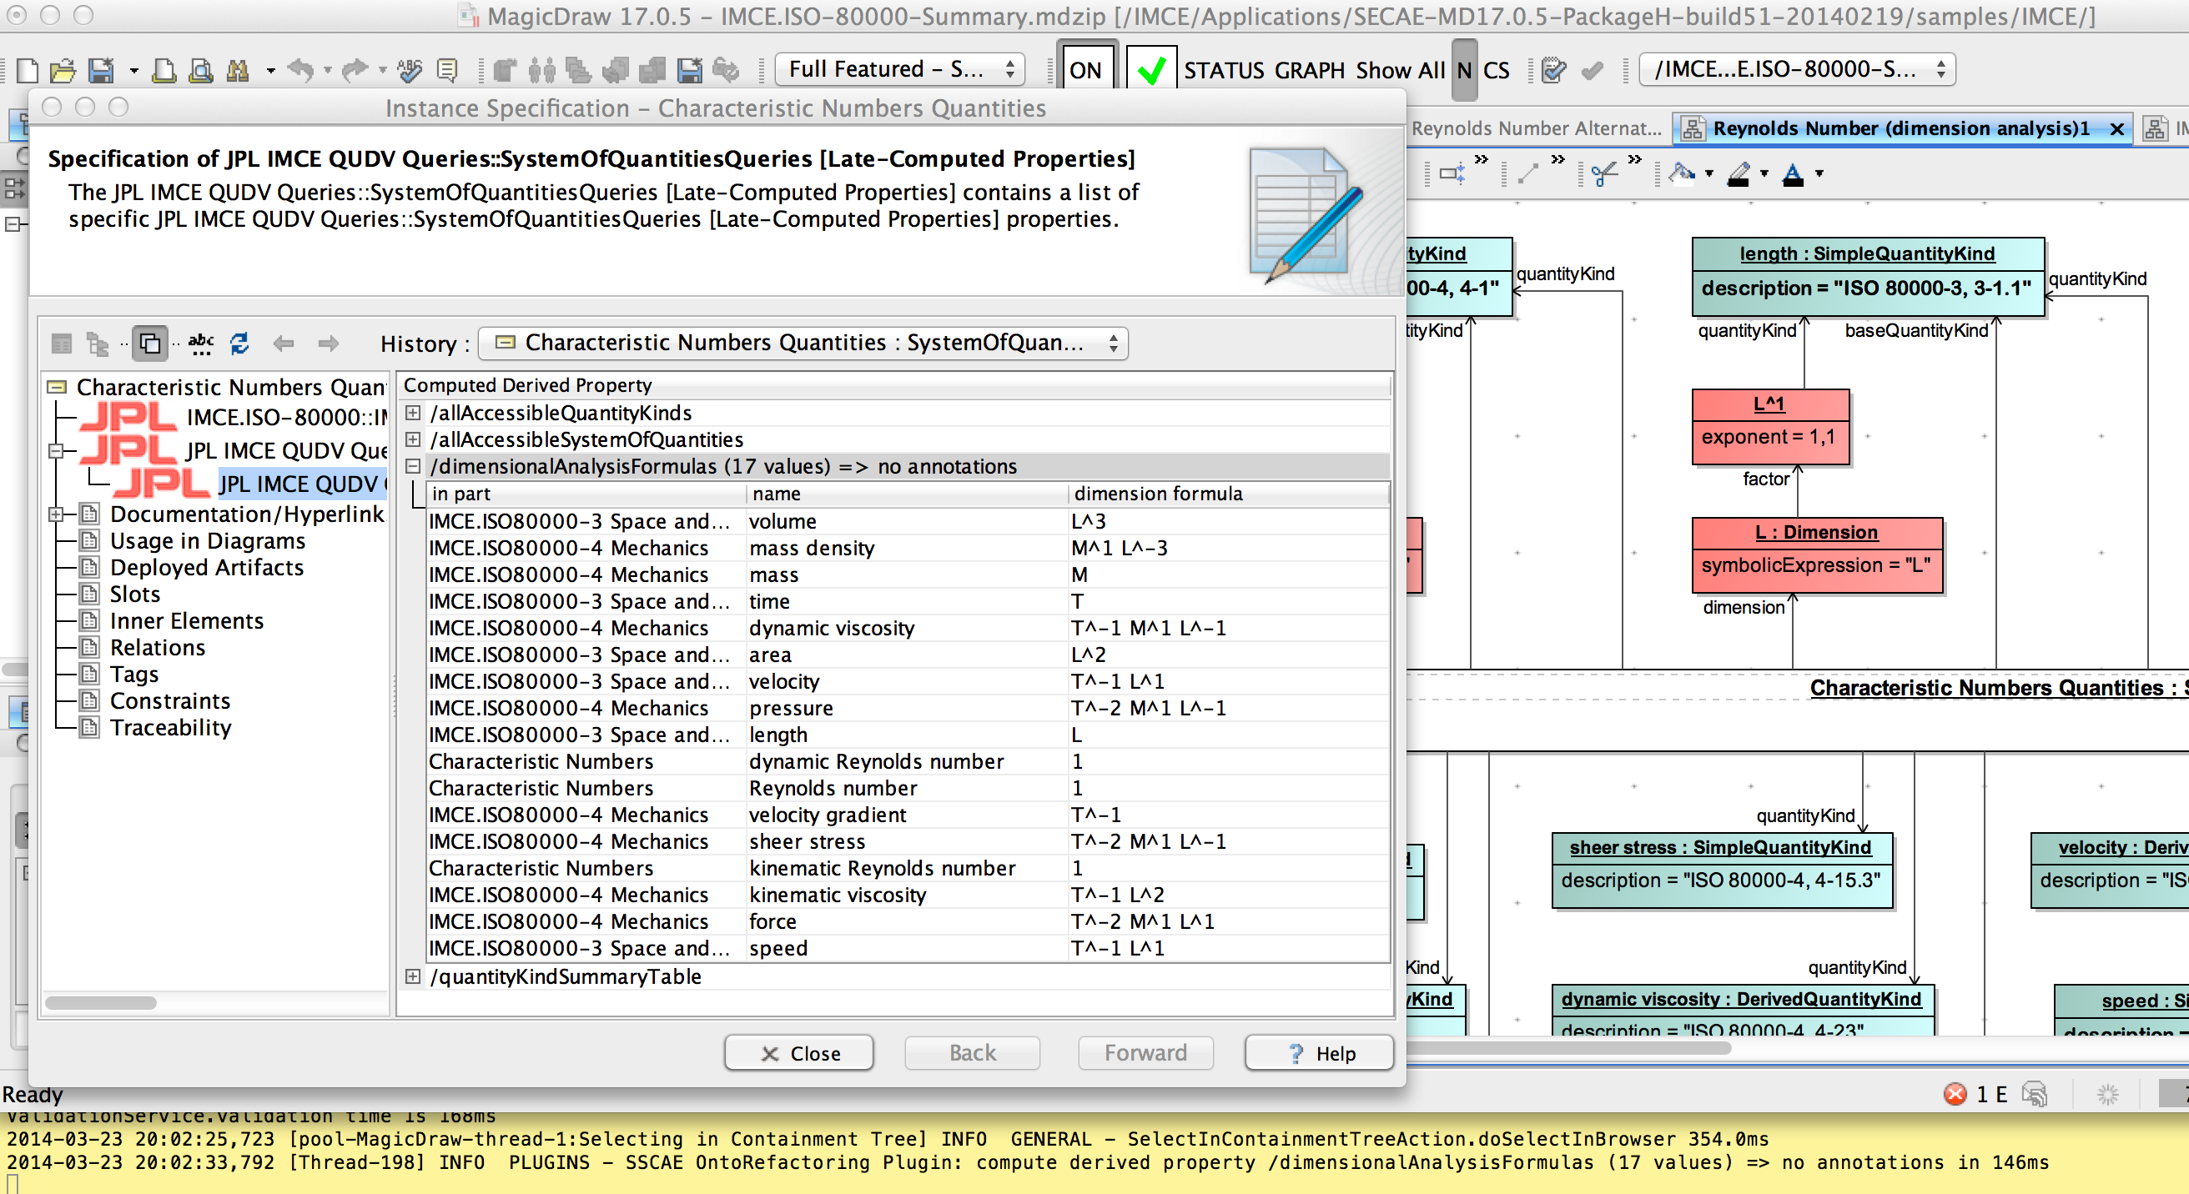
Calculating the Dimension of all Derived Quantities
Example from JPL’s SysML 1.4 QUDV tooling for MagicDraw 17.0.5 SP1:
Dimensional Analysis is calculated for all quantity kinds in scope of a selected SystemOfQuantities (‘Characteristic Numbers Quantities’ in this example) on demand!)

Slide 35
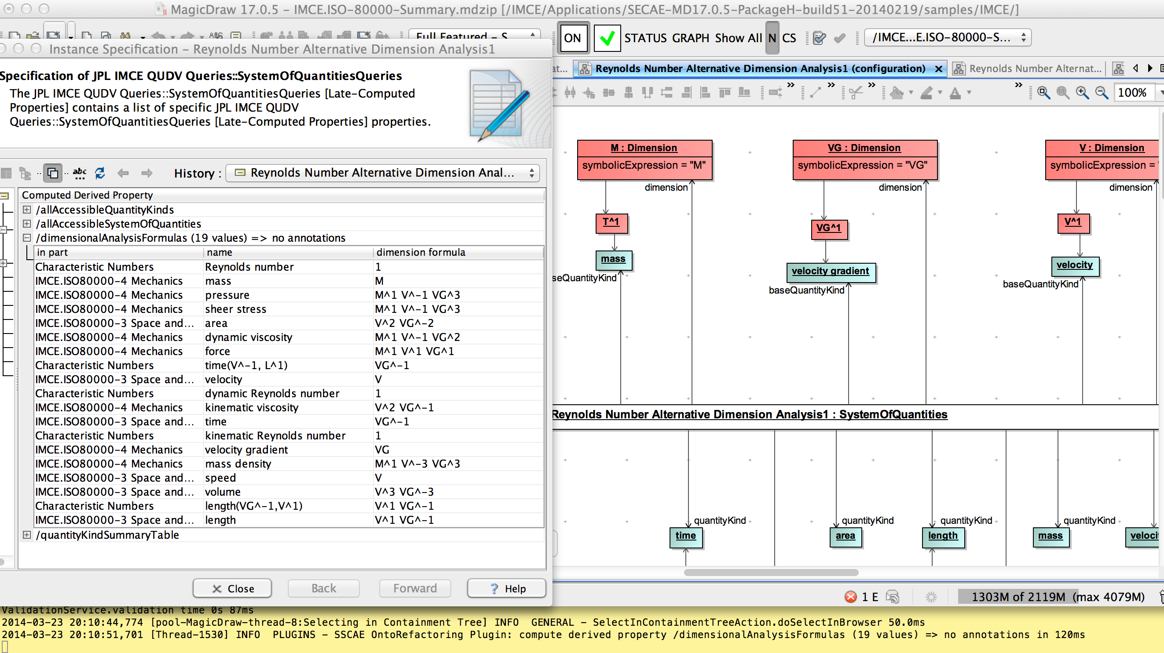
Alternative Dimensional Analysis Formulation
“Base Quantities” is intrinsically a choice made in a System Of Quantities. This example uses a non-standard set of base quantities: mass (M), Velocity Gradient (VG) and Velocity (V)
The rules for Dimensional Analysis are generic and can be applied to any System of Quantities

Slide 36
Summary of SysML 1.4 QUDV & ISO 80000 Library
SysML 1.4 represents a significant leap in capability
QUDV’s expressiveness is adequate for all normative definitions in ISO/IEC 80000 parts 3,4,5,6
QUDV’s semantics is adequate for automated, computer-assisted Dimensional Analysis
In practice, working with QUDV & ISO 80000 emphasizes the need for good tool support for instance & value specification modeling!
SysML 1.4 ISO 80000 (as of December 2013) is significantly affected by SysML issue #16263:
Slots for class-owned association end properties are duplicated (links of such associations & instance specifications of such classes)
Slot duplication leads to circular references that make the ISO 80000 monolithic
Slot duplication is a significant source of inconsistencies and ambiguities!
JPL IMCE ISO 80000 uses the suggested approach in SysML issue #16263:
All JPL IMCE QUDV associations own both association end properties
No slot duplication avoids problems with inconsistencies & ambiguities and enables modularity!
Current OMG paradigms for specifying semantics (e.g. OCL queries, invariants, derived properties) are oblivious to the computational complexity of such semantics
Dimensional Analysis is not cheap! It is a “whole model” graph analysis
The ISO/IEC 80000 library is incomplete and needs careful peer review!
Constructive review feedback and expert contributions welcome!

Slide 37
Backup Material

Slide 38
Historical Review of SysML’s Concepts of Unit & QuantityKind

Slide 39
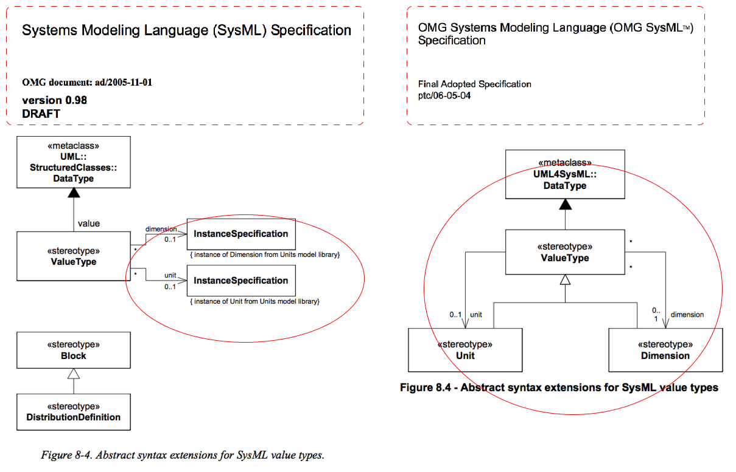
Before SysML 1.0

Slide 40
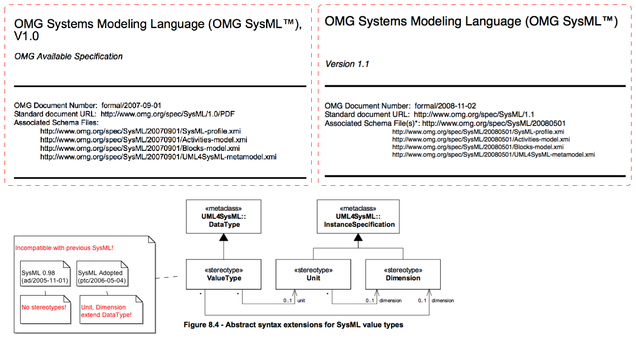
SysML 1.0 & 1.1

Slide 41
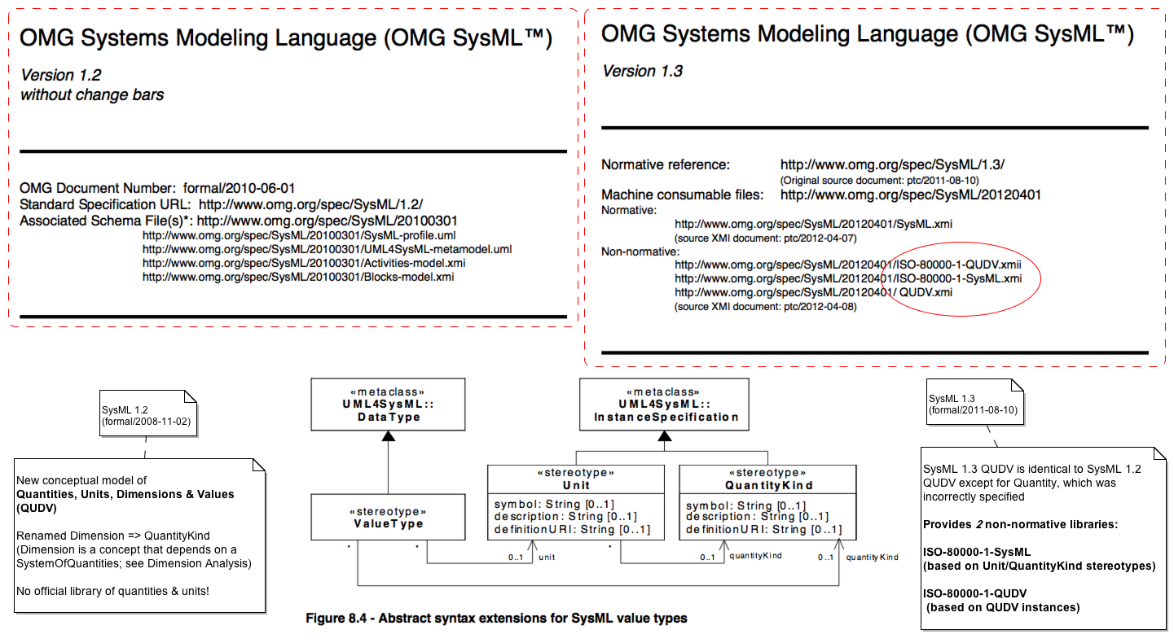
SysML 1.2 & 1.3

Slide 42
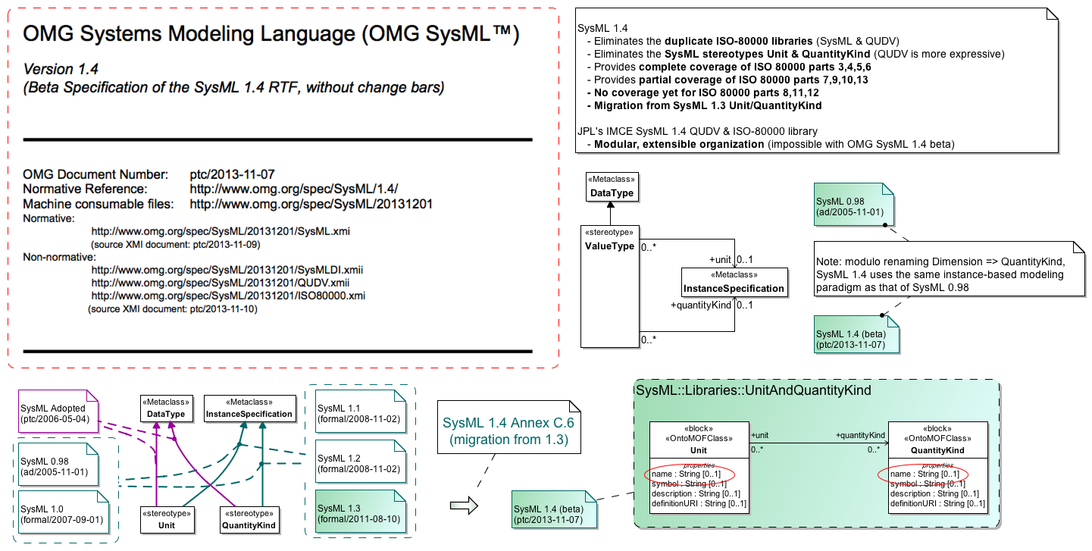
SysML 1.4

Slide 43
Technical Issues
Problems in the ISO/IEC 80000 standards
Modularity & Extensibility
Onto QUDV
Metrology Caveats

Slide 44
Modularity & Extensibility
SysML issue #16263 (May 25, 2011)
Associations in SysML should be able to own their ends. Otherwise modelers can't add an association between blocks in model libraries they do not have permission to modify. They also cannot create association that are non-navigable in both directions, which might be useful for directing flows across them into flows contained by the association as a block.

Slide 45
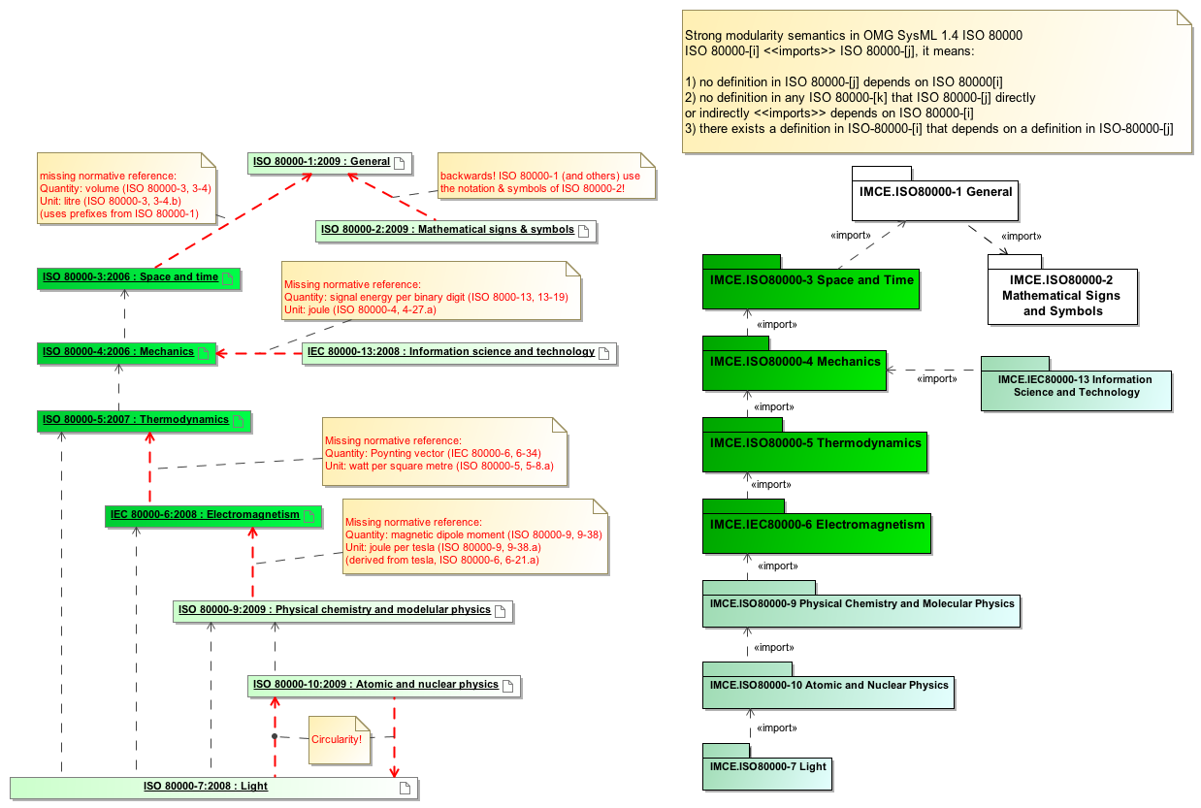
ISO/IEC 80000 Normative References – vs. – Semantic Dependencies & Modularity

Slide 46
References about Metrology
Vocabulary of International Metrology (VIM)
SysML 1.4 QUDV is aligned with VIM 3rd edition
http://www.bipm.org/utils/common/documents/jcgm/JCGM_200_2012.pdf
The Rationale for VIM 3 (scientific papers)
http://www.bipm.org/en/publications/guides/rationale_vim3.html
The Rationale for SysML 1.4 QUDV (subset of above)
ISO terminological analysis of the VIM3 concepts ‘quantity’ and ‘kind-of-quantity’, Dybkaer R., Metrologia, 47(3), 2010, 127-143 http://dx.doi.org/10.1088/0026-1394/47/3/003
This paper is a small excerpt from Dybkaer’s thesis:
An ontology on Property for Physical, Chemical and Biological Systems, Dybkaer R., Copenhagen University Hospital, Denmark, 2009
http://ontology.iupac.org/ontology.pdf

Slide 47
Excerpt from:
“ISO terminological analysis of the VIM3 concepts ‘quantity’ and ‘kind-of-quantity’”
See #46 for references

Slide 48
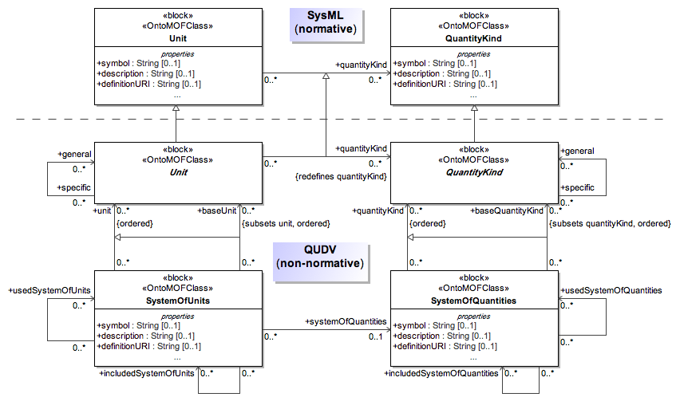
SysML 1.4 Metrology Vocabularies: SysML Profile & QUDV

Slide 49
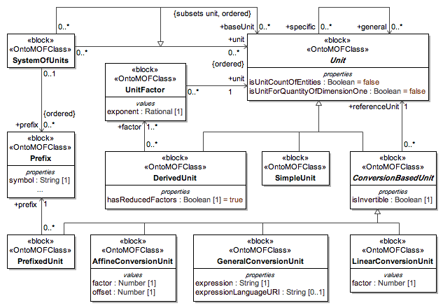
Expanded Unit Vocabulary in QUDV

Slide 50
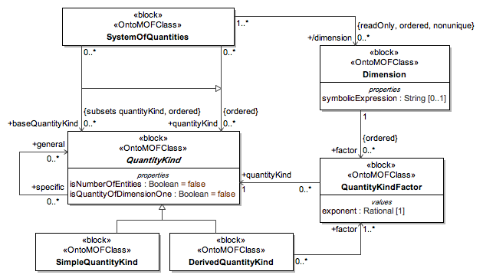
Expanded QuantityKind Vocabulary in QUDV

Slide 51
Practical Considerations for Modeling Values in SysML
#1: Recognize the distinct levels of modeling involved
A Level depends on those above
i < j => Vi depends on Vj
V4 < V5
See VIM3 & ISO 80000-1 foreword:
This first edition of ISO 80000-1 cancels and replaces ISO 31-0:1992 and ISO 1000:1992. The major technical changes from the previous standard are the following:
 the structure has been changed to emphasize that quantities come first and units then follow;
V3 < V4, V5
Per SysML ValueType
V2 < V3
Per UML TypedElement/Type relationship
V1 < V2
Per UML ValueSpecification/Slot/ StructuralFeature & defaultValue relationships
QuantityKinds
V5
V4
Units
ValueTypes
(QuantityKind, Unit)
V3
Value Properties
(typed by ValueTypes)
V2
Value Specifications
(typed by ValueTypes)
V1
V0
Runtime Values

Slide 52
Practical Considerations for Modeling Values in SysML
#2: Recognize the alignment with UML
QuantityKinds
V5
UML InstanceSpecifications
(classifier = SysML or QUDV
Unit or QuantityKind)
V4
Units
ValueTypes
(QuantityKind, Unit)
UML DataTypes
(stereotype = SysML::ValueType
& stereotype tags: quantityKind, unit)
V3
Value Properties
(typed by ValueTypes)
UML Properties
(type = <<ValueType>> UML DataType)
V2
Value Specifications
(typed by ValueTypes)
UML ValueSpecifications
(type = <<ValueType>> UML DataType)
V1
V0
Runtime Values
Varies by methodology

Slide 53
Practical Considerations for Modeling Values in SysML
#3: Recognize the implications of DataType modeling in UML
Choices made about datatype modeling…
ValueTypes
(QuantityKind, Unit)
UML DataTypes
Scalar?
Structured?
V3
Value Properties
(typed by ValueTypes)
V2
… have implications for modeling values…
Value Specifications
(typed by ValueTypes)
UML ValueSpecifications
Literals?
Expressions?
Intervals?
Instance Specifications?
V1
To Be Decided
V0
Runtime Values
… and type checking !
The conformance of a ValueSpecification
to a ValueType depends on these choices!

Slide 54
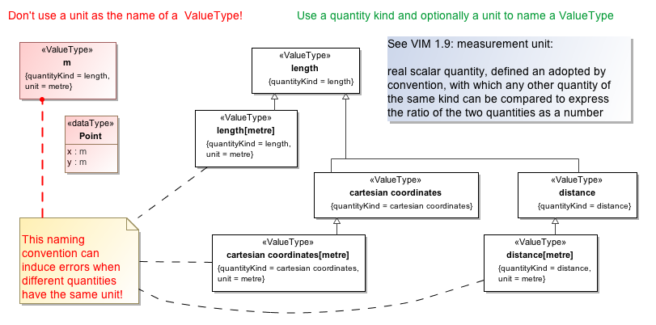
Note about naming ValueTypes
Notes:
----- Meeting Notes (3/14/14 15:00) -----
same unit used for 2 quantities...

Slide 55
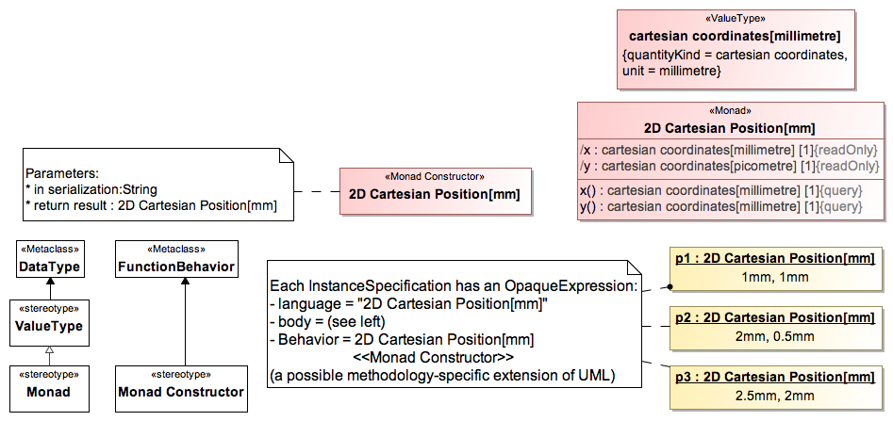
2D Cartesian Geometry Example (Alternative: Monadic ValueType)
http://en.wikipedia.org/wiki/Monad_(functional_programming)
The semantics of UML DataTypes are well-suited for “functional modeling”

Slide 56
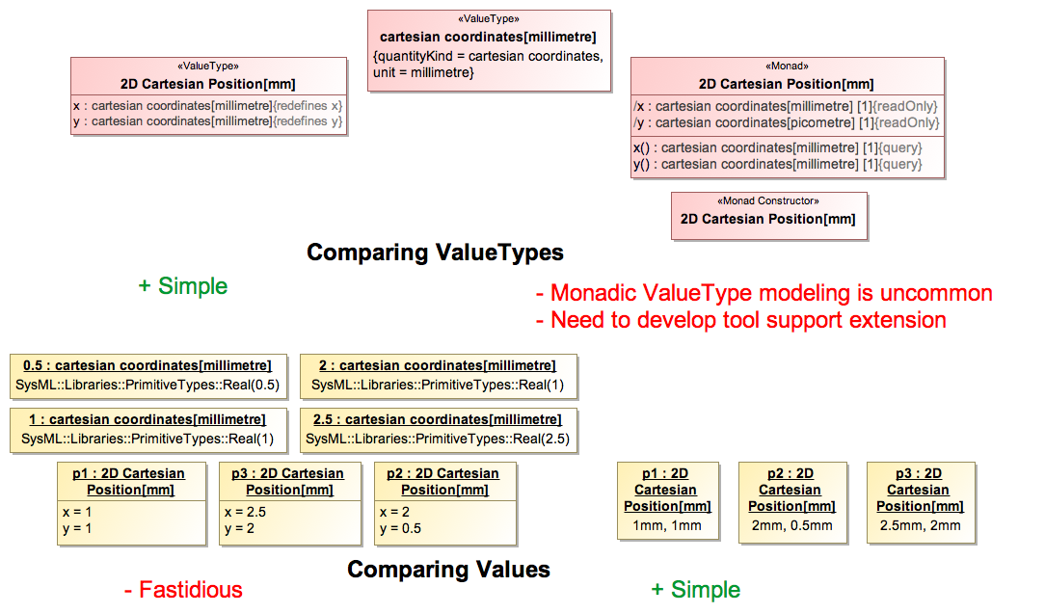
Comparing Models 2D Cartesian Geometry
Comparing types & values/instances is important for assessing the pros/cons of a particular modeling methodology and for adopting one!

